Slide 1
Caraway
Ada Pici, Charlotte Andry,
Hina Khalid, Safiya Mustafa

Slide 2
Design Problem
Many female students don’t have the resources they need to handle their stress through access to therapists. Caraway provides immediate access to these professionals through their app and help with getting virtual appointments (Home. Caraway, https://www.caraway.health/)
Our Problem: We need an application that will cater to college-aged women, be easily accessible, easy to navigate, and help meet the needs of its users, while also representing Caraway in a professional way.

Slide 3
User Needs
01.
02.
03.
personal support system, consisting of productive conversation around stress and stress management
Affordable or free and convenient therapy sessions
Hobbies in which healthily decrease stress
04.
05.
Option between in-person and online
Ability to see reviews for therapists

Slide 4
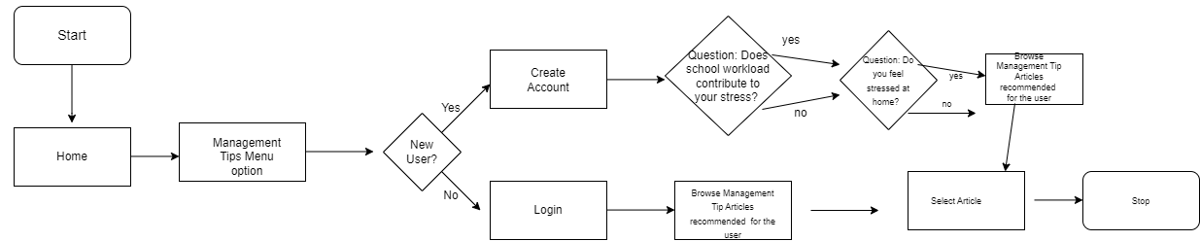
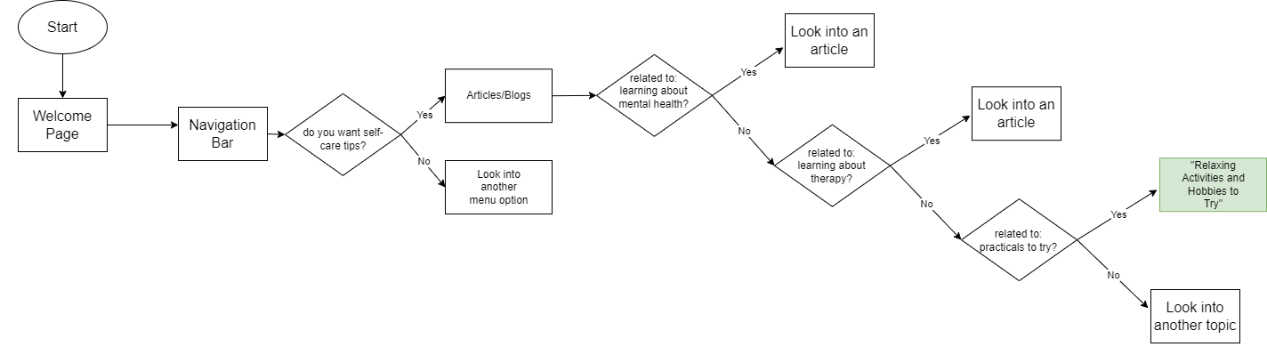
Task-Flow Diagram
Examples
Task:
Finding stress management tips
Task:
Explore a list of hobbies and activities

Slide 5
Link to Wireframe
a link to both wireframe individual screens and higher-resolution annotated wireframe flow diagram
Wireframe Link
Task Flow Diagram Link

Slide 6
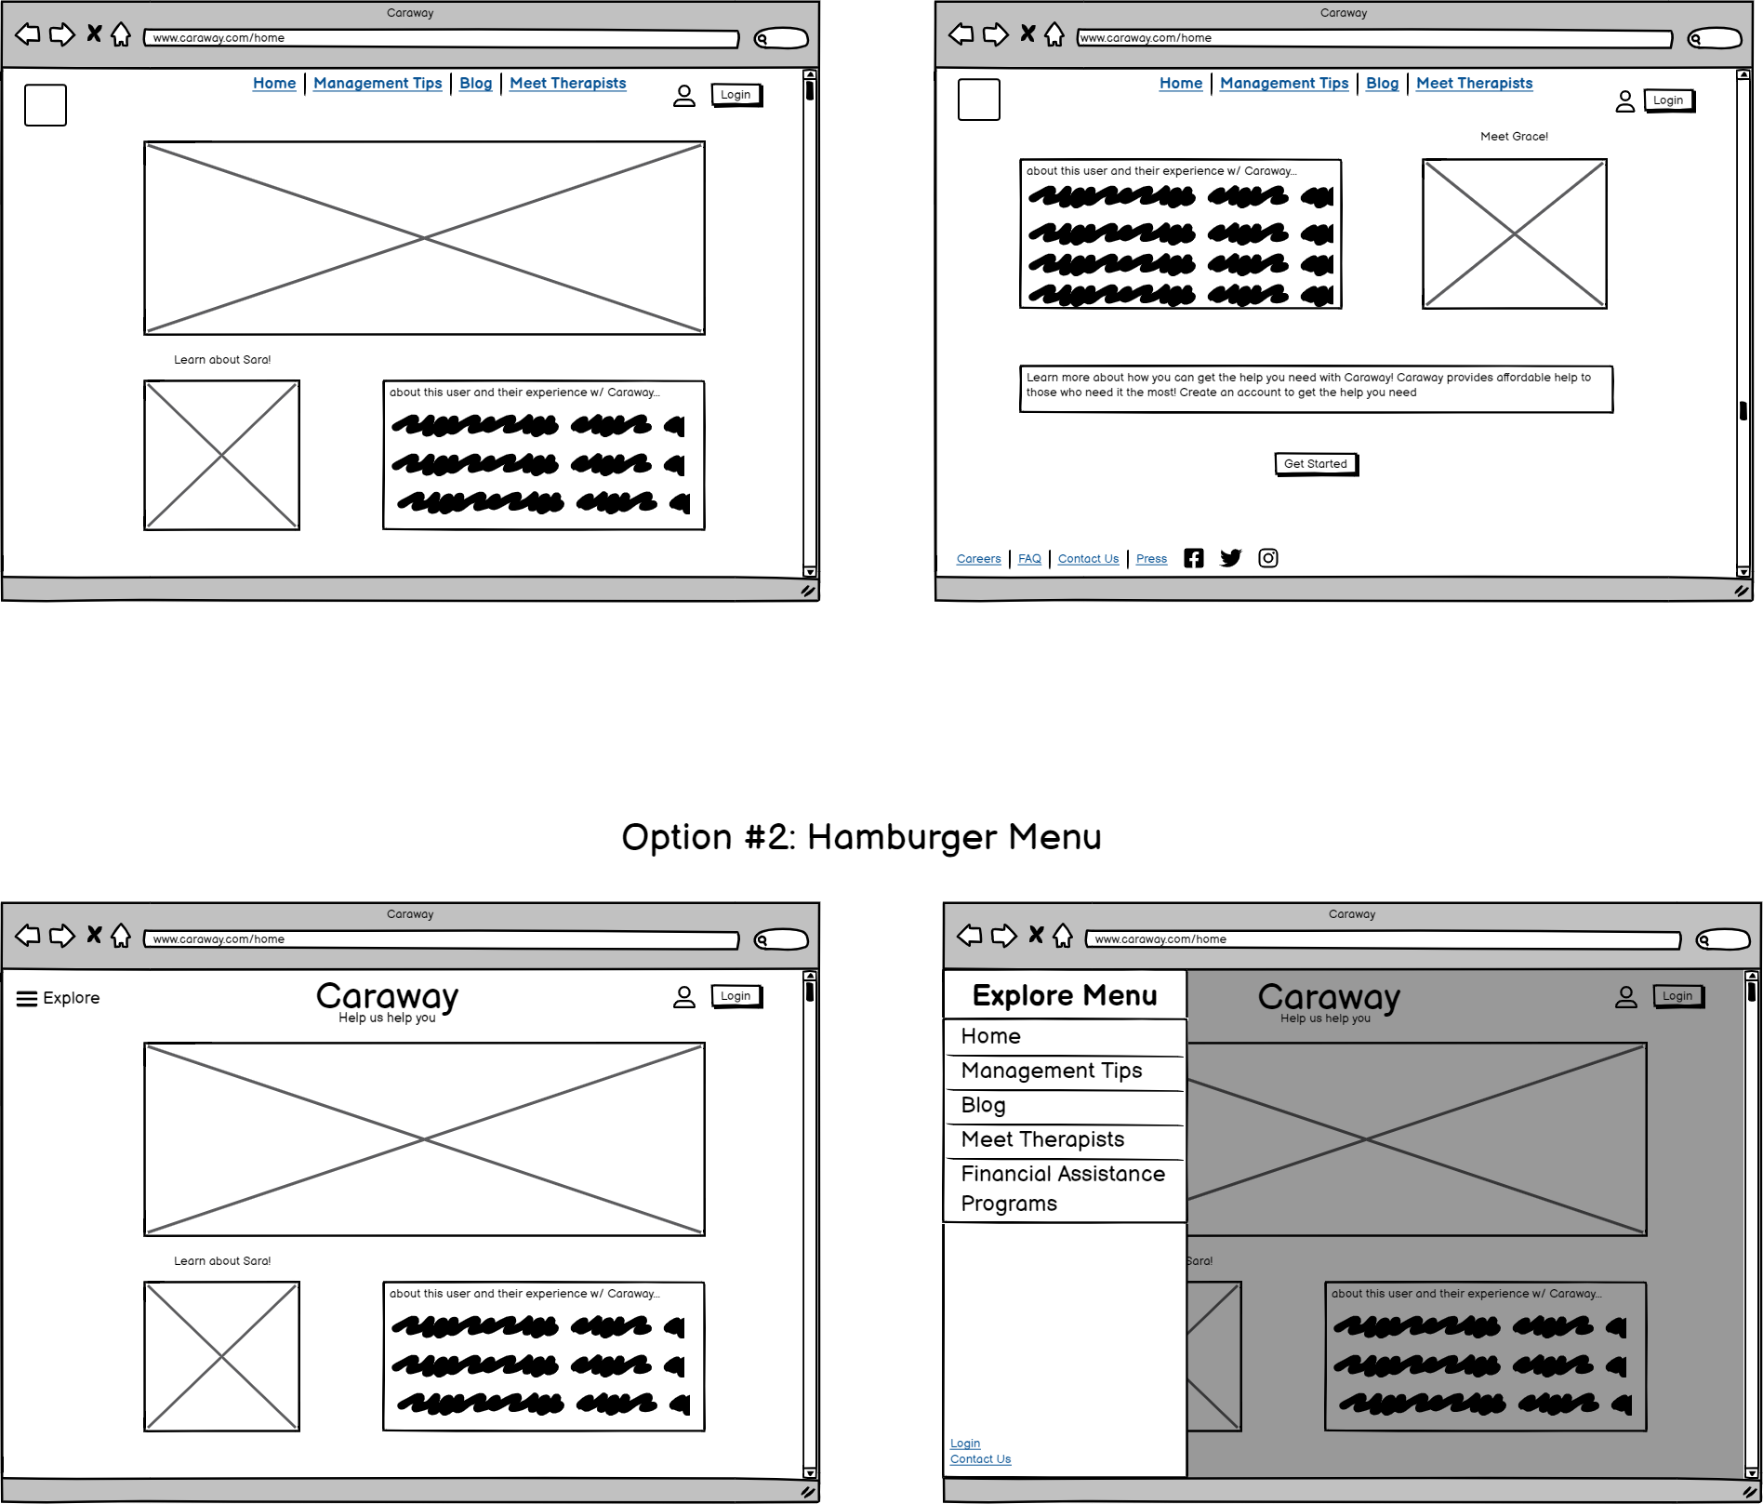
Design Solutions & Alternates
Home Option #1
Home Option #2

Slide 7
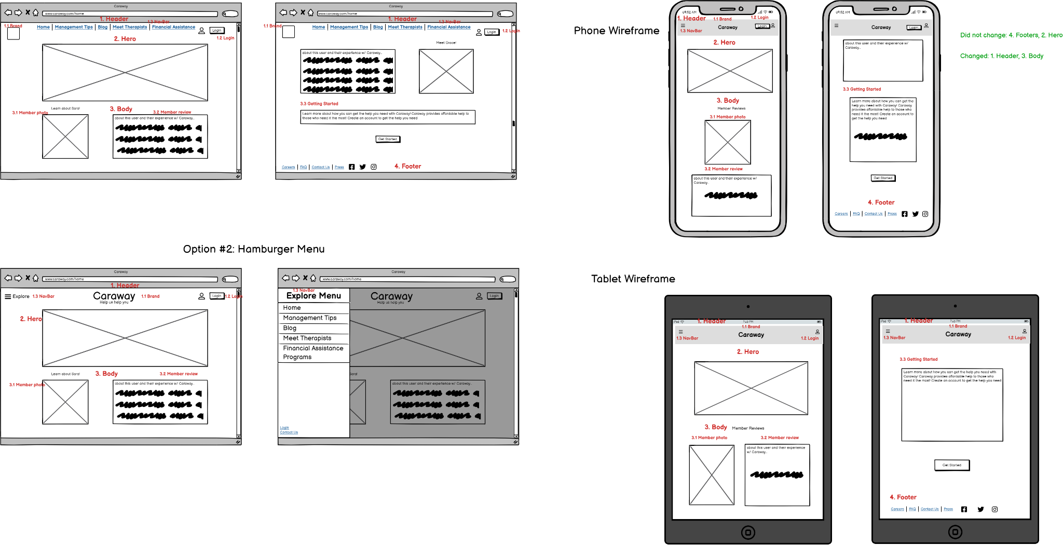
Annotated Screen 1: Home

Slide 8
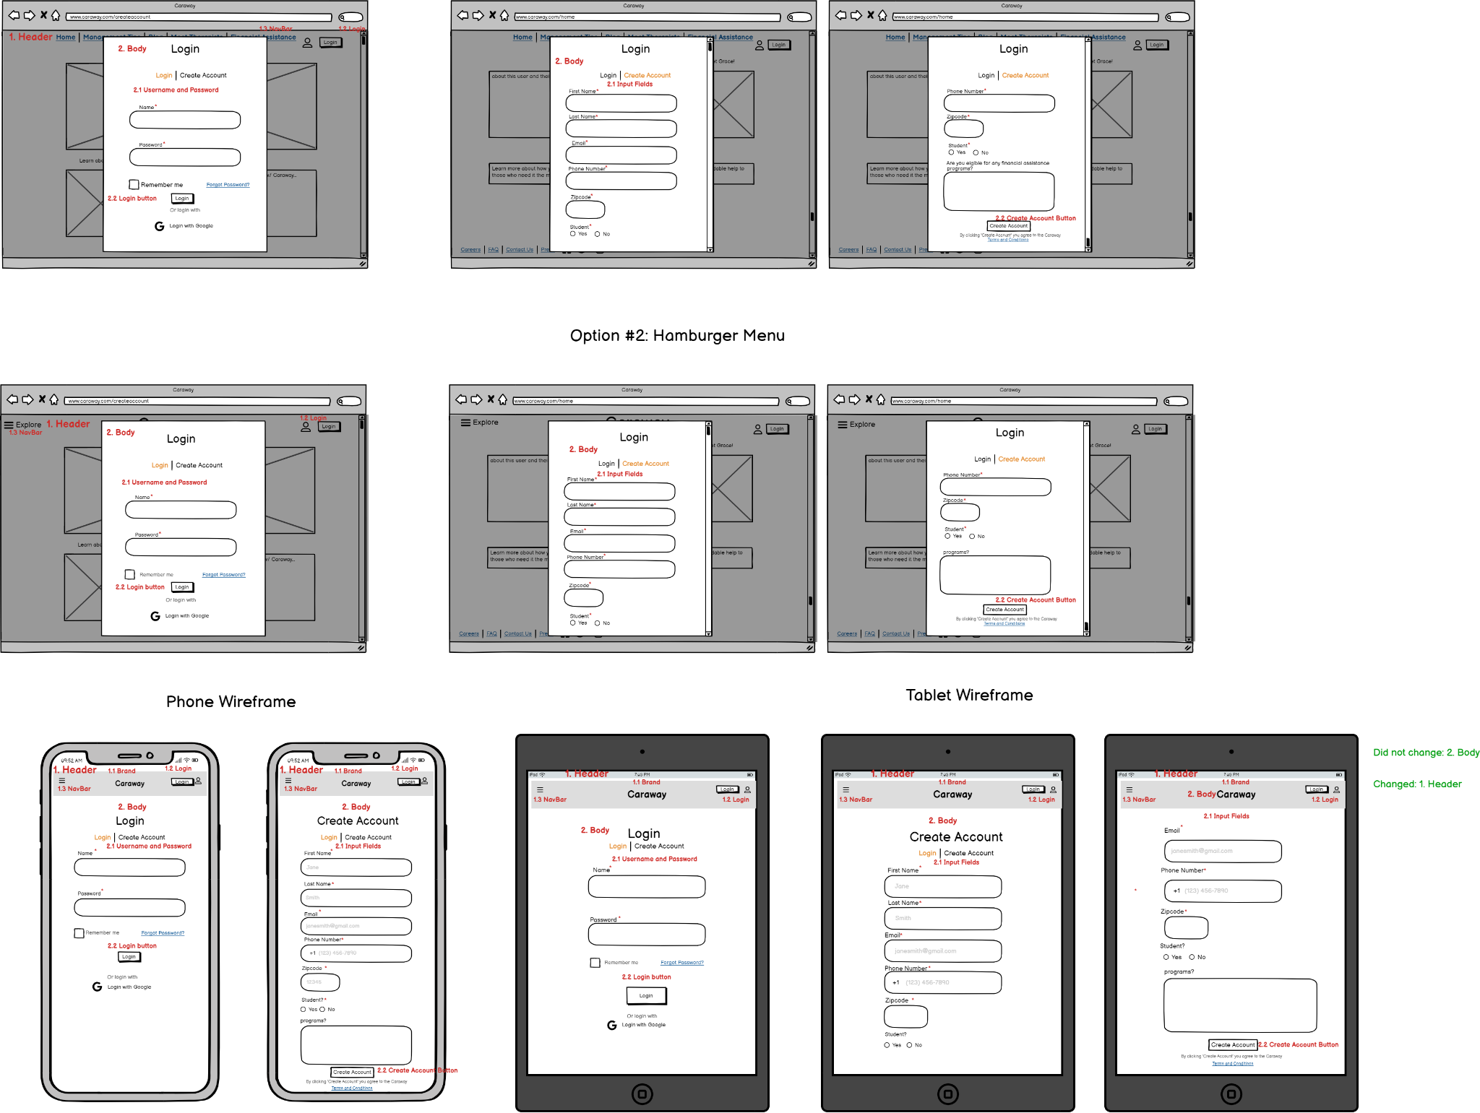
Annotated Screen 2: Create an Account

